Slide 1
Sing praises to Jehovah, O you saints of His, and give thanks at the memory of His holiness.
Welcome To Our Services

Slide 2
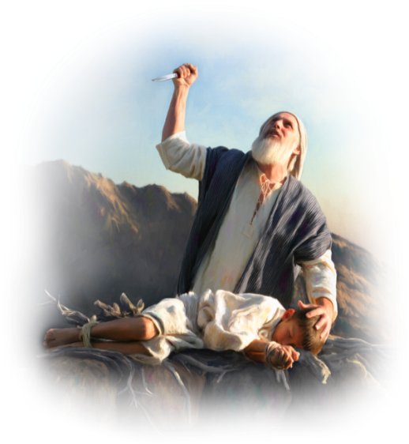
The Great Faith of Abraham
Rom.4:17-22
Jam.2:17-24

Slide 3
Genesis 22 - What Didn’t Happen
Put it Off, Procrastinate
I Don’t Understand Lord, Unclear
Argue and Dispute With Human Reasoning
I Love My Son TOO Much
Start Out Good, Then Quit
Make Excuses: Tired, Old, Busy, Tied Up
Some Preacher Told Me Different
I Believe, Faith Only

Slide 4
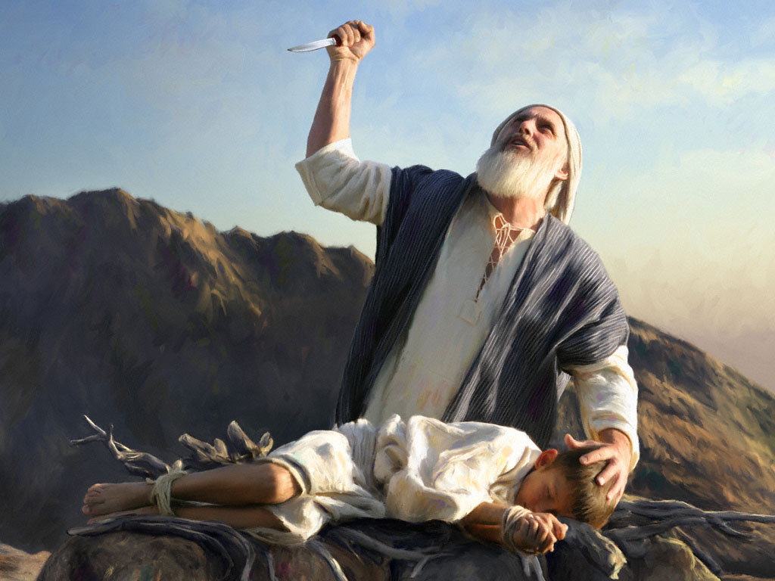
Genesis 22 What Did Happen
Listening
Faith
Obedience
Trust
Confidence
Submit

Slide 5
Genesis 22 What Did Happen
Vs.1, A Test
Vs.2, Clear Instructions
Vs.3, Very Early Morning
Vs.4, Time to Think
Vs.5, The Opinion of Abraham, Heb.11:17-19
Vs.6, Made Preparations
Vs.7, A Very Hard Question
Vs.8, Wisdom of the answer
Vs.9-10, Dead in the Mind of Abraham
Vs.11-12, He passed the Test
Vs.13-14, Jehovah Provides
Vs.15-18, God Blesses the Faith of Abraham.

Slide 6
Do You Have Faith In God?
Hear the Gospel of Christ, Rom.10:17
Believe in Jesus Christ, Jn.3:16
Repent and Turn to God, Luke 13:5
Confess Jesus Before Men, Matt.10:32
Baptized For Forgiveness, Acts 22:16
---------------------------------
Grow and Seek The Lord, Col.3:1-4
2nd Law of Pardon If We Err: Repent and Pray God Acts 8:22

Slide 7
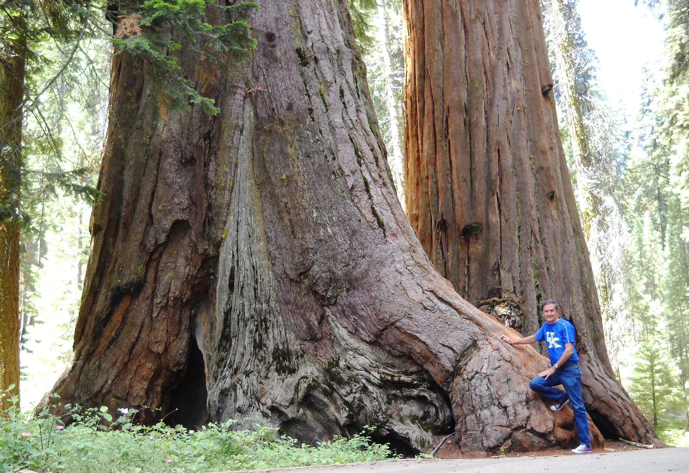
Thank You For Coming
www.sunnyhillcoc.com

